Slide 1
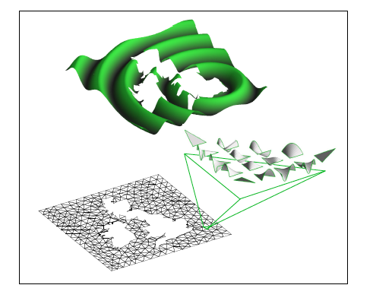
Generalities on Spectral/hp element method

Slide 2
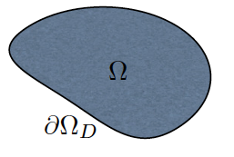
Driving example: Poisson Problem
Starting Point: Weak Formulation of the problem
Find such that satisfies the boundary conditions and such that for all ,
Nektar++

Slide 3
Finite Element Method
Approximation of the solution and force by piecewise functions over N subdomains :
Substitution into the weak form of the problem allows to evaluate unknown coefficients .
Two different approaches for the problem:
h-type methods
p- type methods

Slide 4
hp-type methods
Fixed order polynomial in every element
Convergence achieved by reducing the size of elements
h-type methods
Fixed mesh
Convergence achieved by increasing the order of the polynomial in every element
p-type methods
hp-type methods: h-type decomposition to generate the initial mesh upon which p-type extension is applied

Slide 5
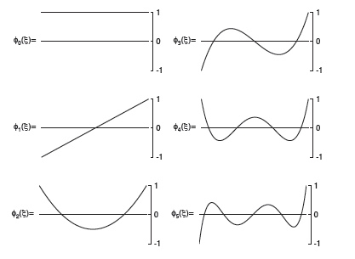
Legendre expansion
Legendre expansion within the standard region
where,
Property of Jacobi polynomials

Slide 6
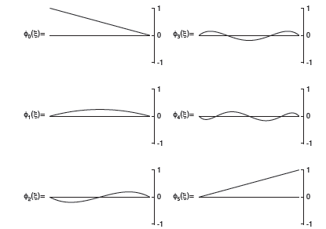
P-type finite elements

Slide 7
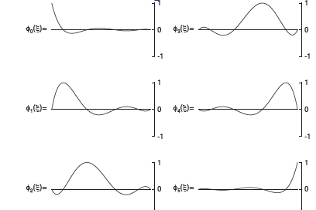
Spectral/hp element method
Spectral/hp element method uses the Lagrange polynomial through the zeros of the Gauss-Labotto polynomials.

Slide 8
Nektar++

Slide 9
Nektar++ What is it?
Nektar++ is an open source software library currently being developed and designed to provide a bridge to the community to provide a toolbox of data structures and algorithms which implement the spectral/hp element method yielding fast error convergence. It is implemented as a C++ object-oriented toolkit which allows developers to implement spectral element solvers for a variety of different engineering problems.
For more information, go to:
www.nektar.info

Slide 10
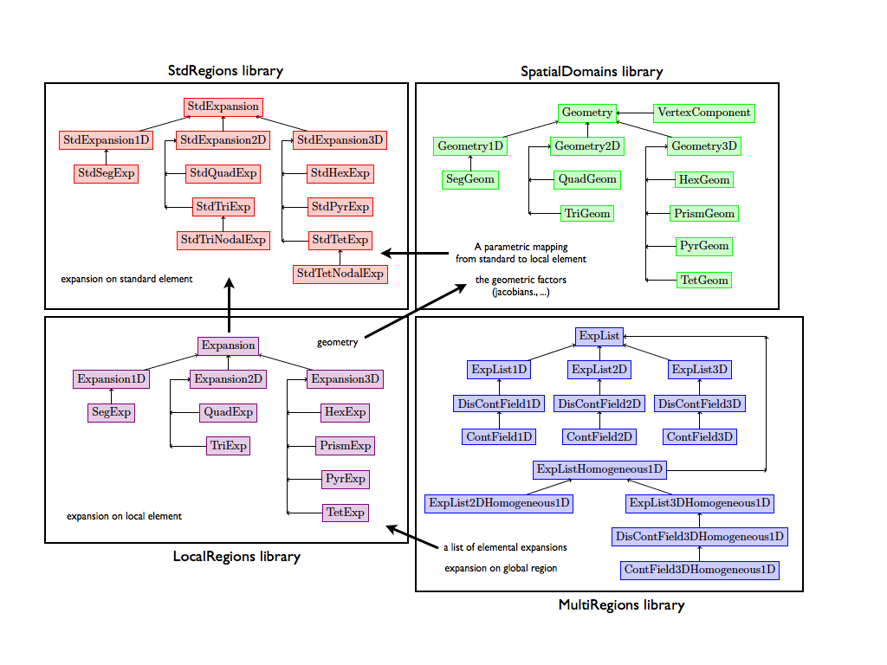
Overview of Nektar++ Structure

Slide 11
Expansions in Standard Regions (StdRegions)

Slide 12
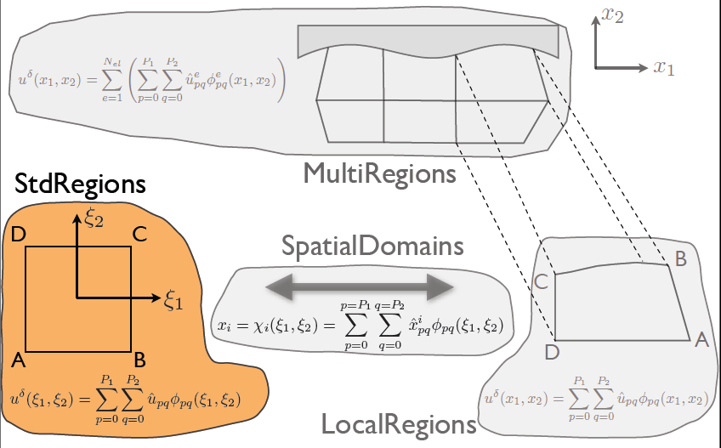
StdRegions Library

Slide 13
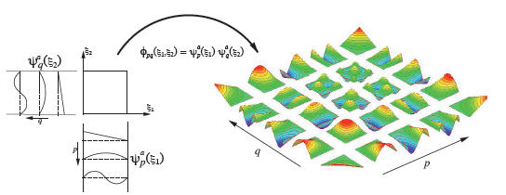
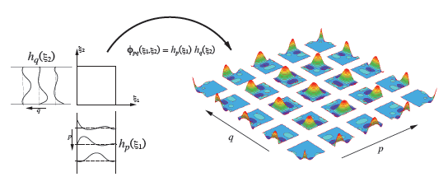
Spectral element/P-type finite element
P-type finite element- hierarchical basis
Spectral element- collocation basis

Slide 14
Tensor product bases & sum factorisation
Inner product:

Slide 15
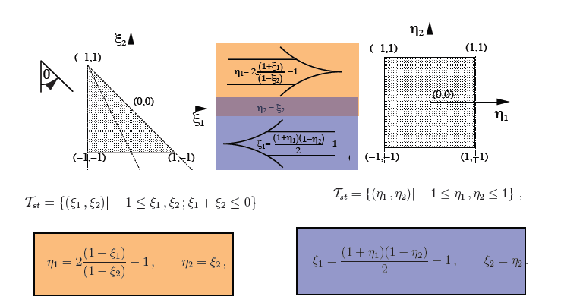
Collapsed coordinate system
2 coordinates in 2 dimensions.
Not rotationally symmetric.
Analogous system used in cylindrical coordinate system.

Slide 16
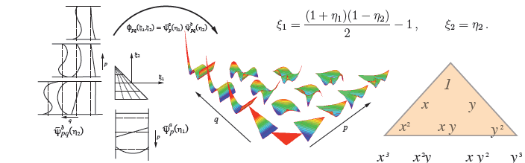
Orthogonal Expansion
Principal functions:
Generalised tensor products:
Quadrilateral expansion:
Triangular expansion:

Slide 17
Spatial Construction of Elements (SpatialDomains)

Slide 18
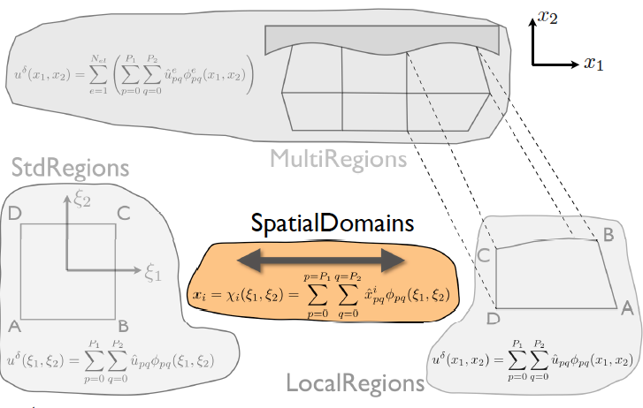
StdRegions Library

Slide 19
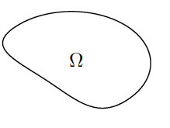
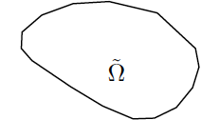
Approximating the Geometry
Find such on subject to boundary and initial conditions
Approximation of Domain
Tessellation of Domain
True Domain

Slide 20
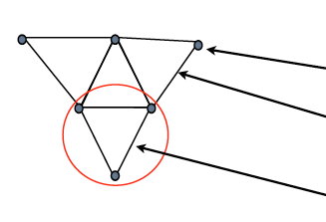
Mesh
Mesh- a collection of vertices, edges and faces which form elements
Vertex
Edge
Element
Supported Element:
Dimension | Elements
1-D | Segments
2-D | Triangles Quadrilaterals
3-D | Tetrahedra Hexahedra Prisms Pyramids

Slide 21
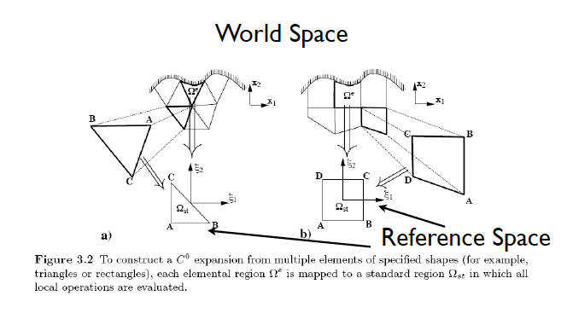
World Space vs Reference Space

Slide 22
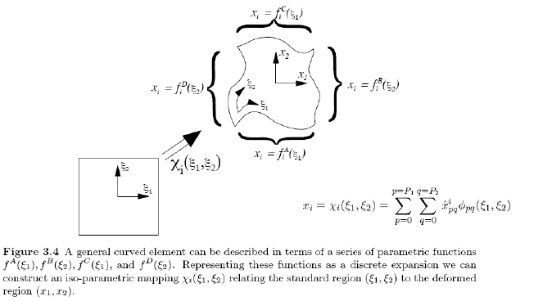
Mapping from reference space to world space

Slide 23
Expansions in Local Regions (LocalRegions)
Nektar++

Slide 24
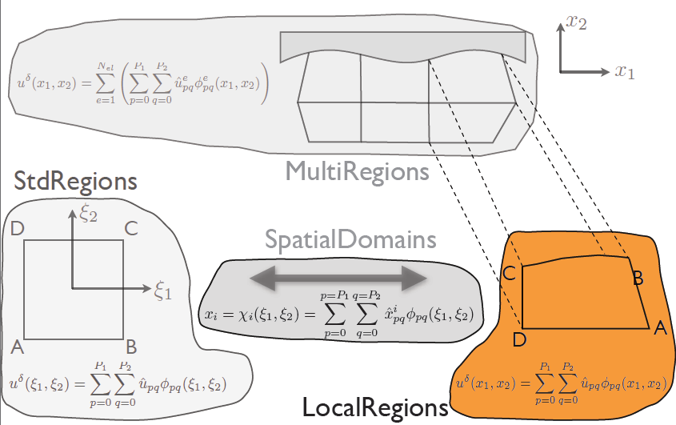
LocalRegions Library

Slide 25
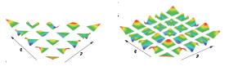
Elemental forward transform LocalRegions::QuadExp/TriExp::FwdTrans()
Expansion:
Approximation:
Method of weighted residual:
Setting

Slide 26
Elemental forward transform LocalRegions::QuadExp/TriExp::FwdTrans()
Considering the Galerkin weight:

Slide 27
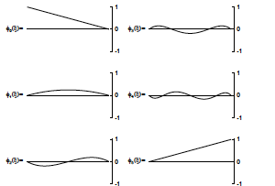
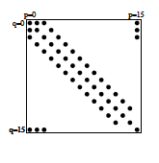
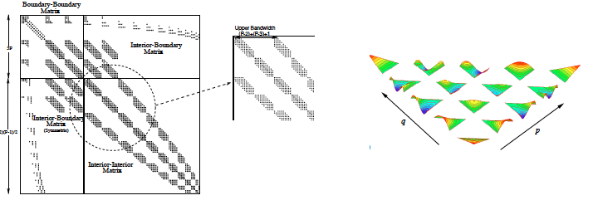
Elemental Mass Matrix Structure
Segment expansion P=15
Triangular expansion P=14

Slide 28
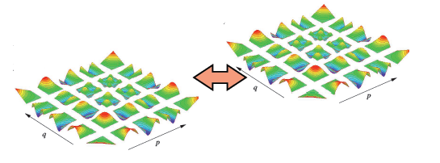
Global Assembly
Classical continuous Galerkin FEM
II order Partial differential equation
C⁰ continuity sufficient
Use boundary interior decomposition to make continuous expansion.

Slide 29
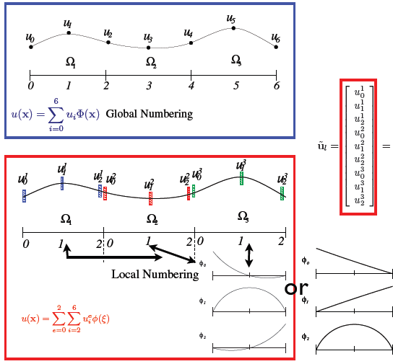
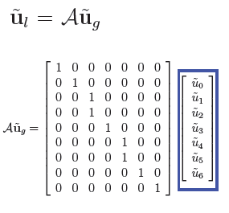
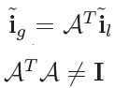
Global Assembly

Slide 30
Expansions in Multiple Regions (MultiRegions)
Nektar++

Slide 31
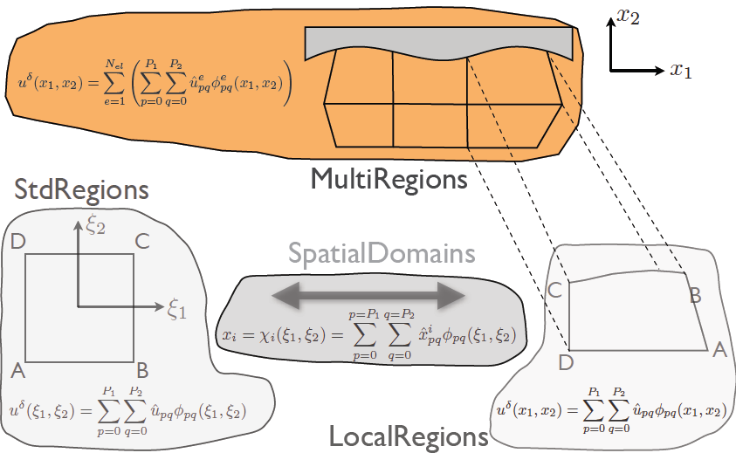
MultiRegion Library

Slide 32
Poisson problem
1-D Poisson Problem
Weak Formulation:
Enforcing Neumann Boundary conditions:
Enforcing Dirichlet
Boundary conditions
(Lift BC)

Slide 33
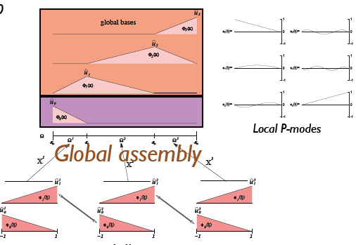
Discrete Approximation
Substituting the decomposition in the weak formulation:
Global approximation – C⁰:
Local approximation

Slide 34
Discrete spaces
Global approximation – C⁰:
Local approximation:

Slide 35
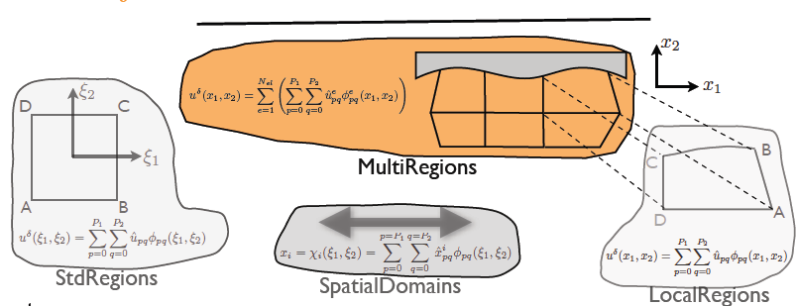
Evaluation of f[i]

Slide 36
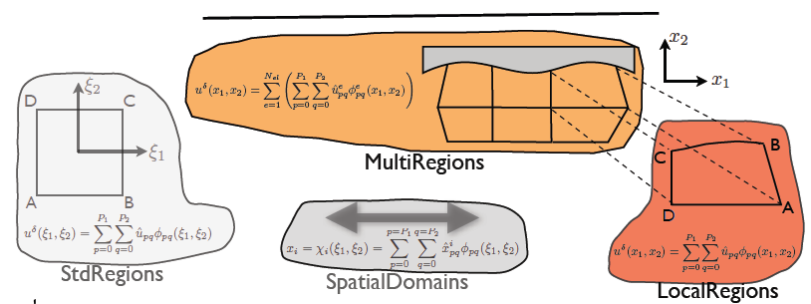
Evaluation of f[i]

Slide 37
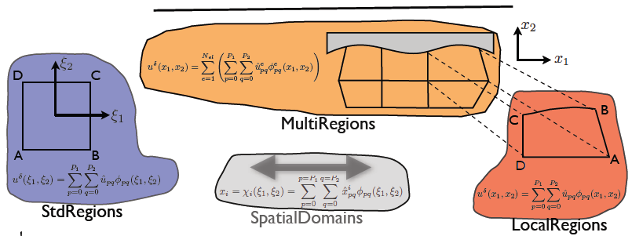
Evaluation of f[i]

Slide 38
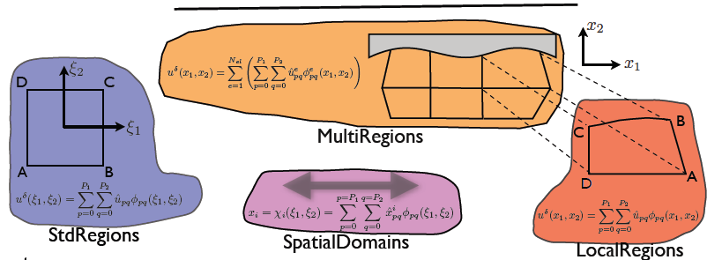
Evaluation of f[i]

Slide 39
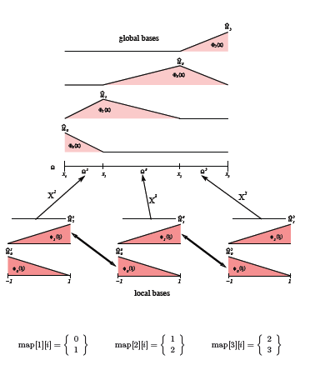
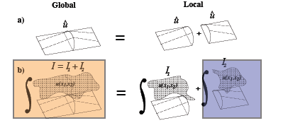
Global Assembly

Slide 40
Matrix Construction

Slide 41
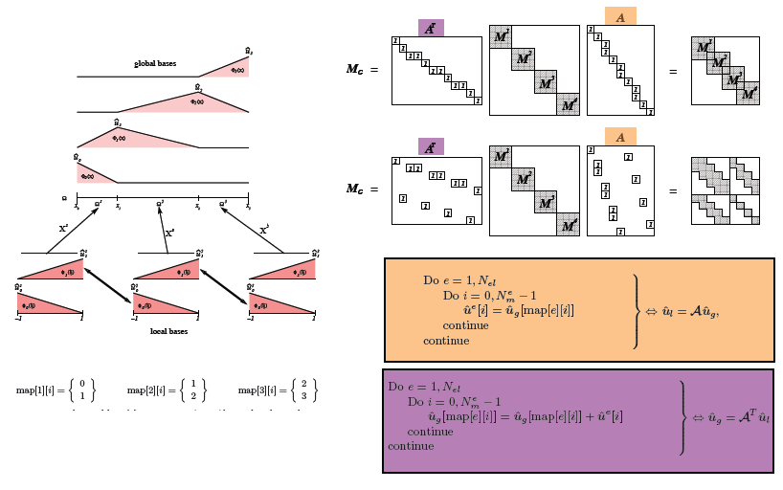
Matrix Construction

